Slide 1
Amazon Reviews Sentiment Analysis
By Ashika Anand Babu and Ramya Mahesh and Anusha Gangasani Team: Conquerors

Slide 2
CONTENT
Data
Visualisation
Modeling
Deployment

Slide 3
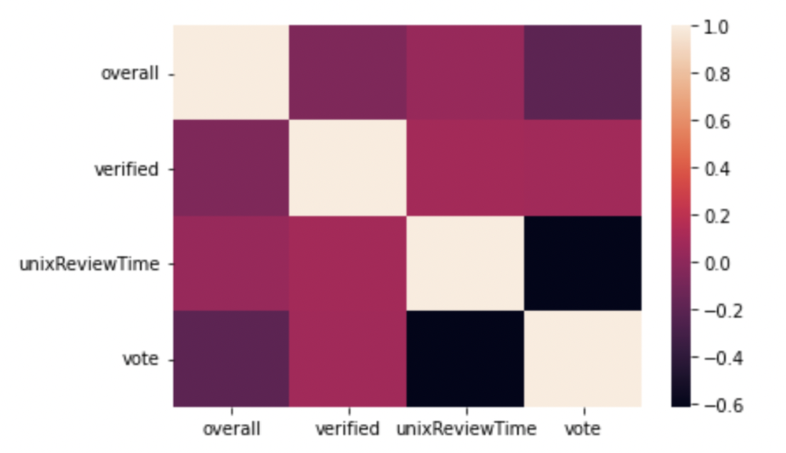
DATA
The data used for the Amazon review sentiment analysis is gathered from UCSD EDU
This contains a subset of the data in which all users and items have at least 5 reviews
A total of 41.13 million reviews

Slide 4
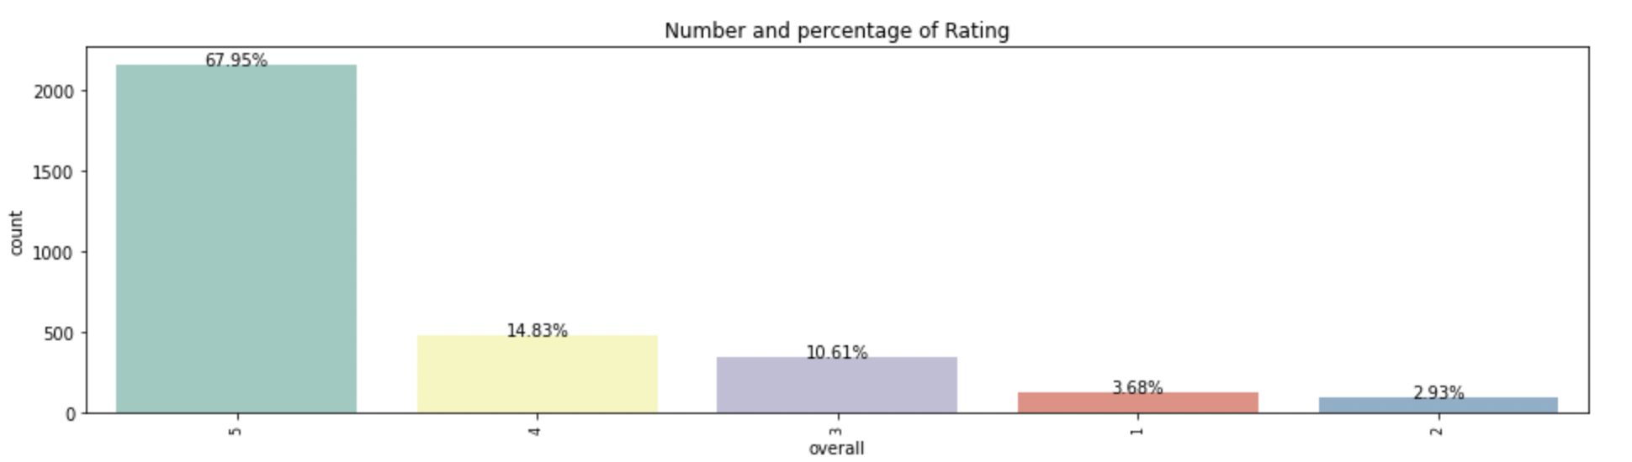
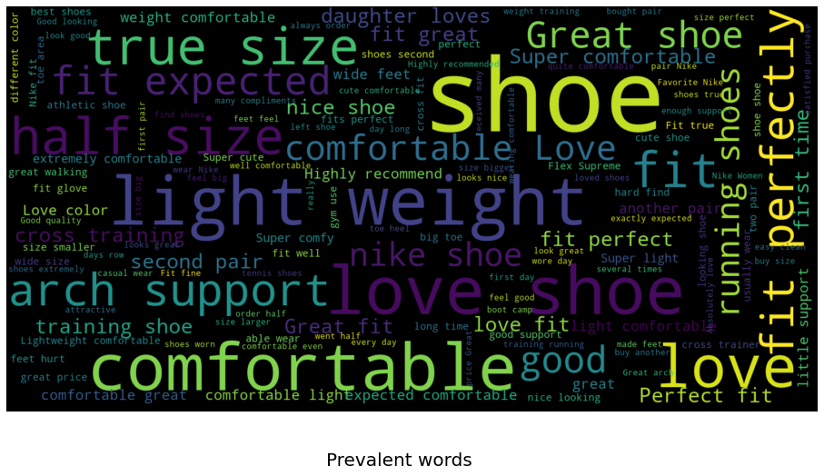
Visualization
Rating to it’s sum:
Prevalent words in fashion dataset:

Slide 5
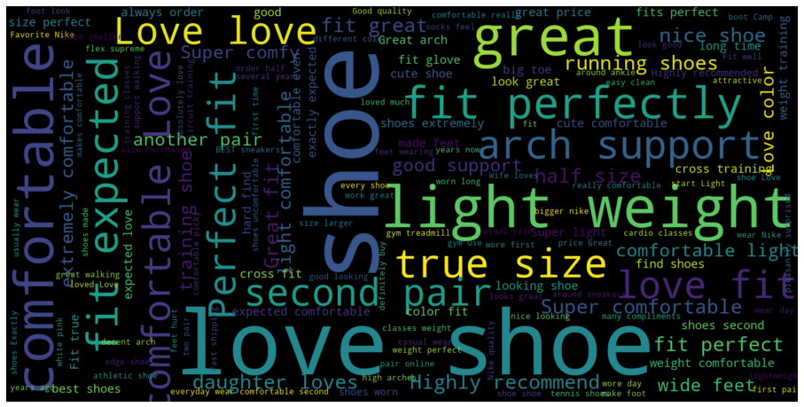
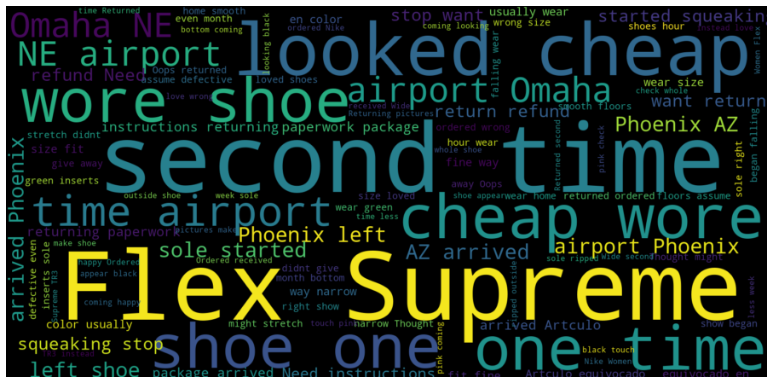
Visualization
Prevalent Words in 5 star review :
Prevalent Words in 1 star review :

Slide 6
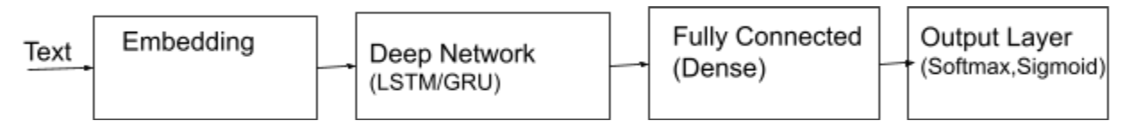
MODEL
Model 1: Sequential LSTM
Model 2 : Pre trained HuggingFace model
Model 3: Sentiment analysis using Bert model

Slide 7

DEPLOYMENT
Dumped model into pickle file
Loaded the pickle file into AWS EC2 instance

Slide 8
Thank You!

